Slide 1
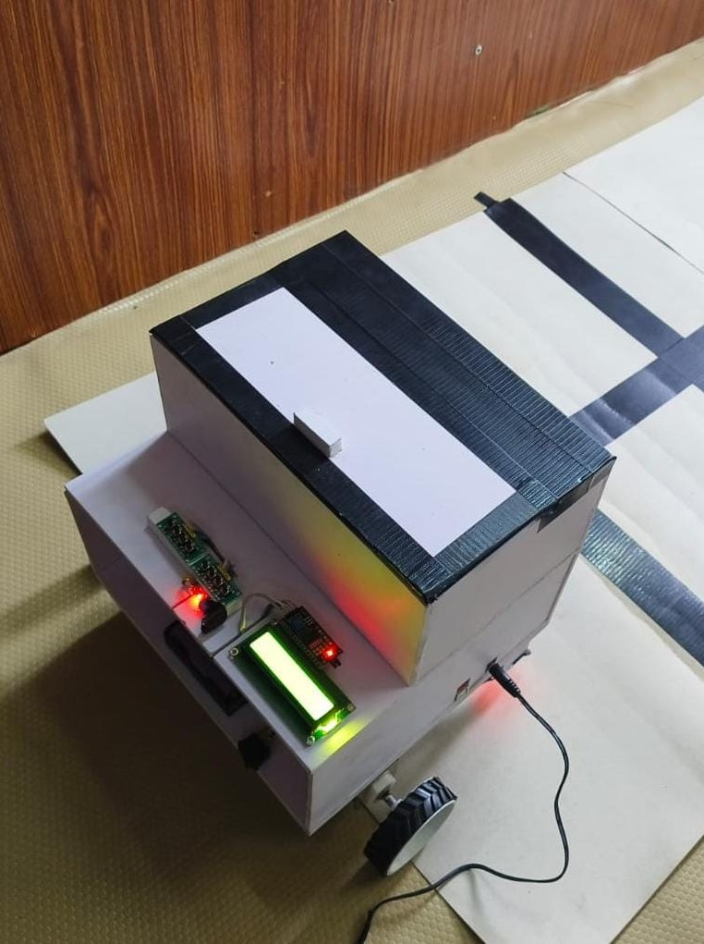
Autonomous Medical Supply Delivery Robot for Hospitals
IPR LEVEL 1 | INTERACTION WITH INVENTORS
A low-cost robot that carries medicines to a selected room and returns home
Inventor: : BHUVANAN M, DHARANESHWARAN B, ARAVINTH R, AMBIKA B
Mentor: Mr. A. Kamalakkannan
Knowledge Institute of Technology, Salem | 06-10-2026
Notes:
Introduce yourself, the project title and the purpose: seeking expert guidance on patenting this robot.

Slide 2
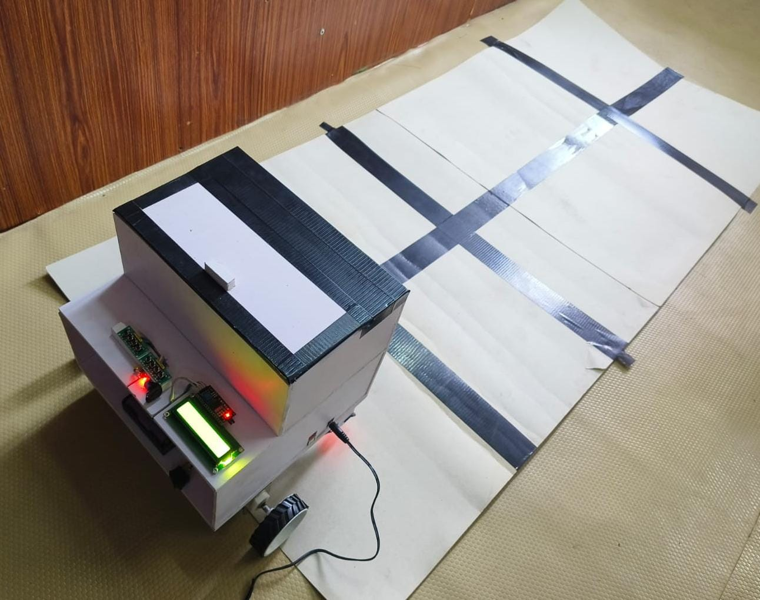
What is this project?
A robot that carries medicines to the room a nurse selects, and comes back on command.
An indoor differential-drive robot: two rear 12 V DC gear motors, a front ball-transfer wheel and an Arduino UNO
controller. IR column sensing finds the room; no camera, map or SLAM.
6+ rooms
Return
Indoor
Working prototype on the test track
selectable
destinations
to starting point
option
hospital corridor
robot
Notes:
Explain in one breath: nurse presses a room switch, robot finds the room by counting floor columns, delivers, and returns Home when asked.

Slide 3
The problem
1
Staff workload
2
Delayed delivery
3
Infection risk
Nurses and helpers walk supplies between store and wards, time that belongs to patients.
Manual transport is slow and uneven at peak hours and during staff shortages.
The same people moving between wards can carry infection, especially in outbreaks.
Today's manual flow
Store / pharmacy
Nurse carries
Ward
Walks back
Problem statement: hospitals lack an affordable, simple robot that staff can send to a chosen room and call back, without costly mapping, cameras or SLAM.
Notes:
Hospitals move supplies by hand. This costs nurse time, causes delays and spreads infection between wards.

Slide 4
Existing solutions
Existing solution | How it works | Limitation
Manual delivery | Staff carry items | Slow; uses nurse time; infection risk
Commercial robots (HOSPI, TUG) | Map-based navigation | Proprietary and very costly
Camera / AI robots (YOLOv5, ROS2) | Camera reads room labels | Needs computer and training; complex
Basic line followers | Follow one taped route | One fixed route; no room choice
Notes:
These are the options hospitals have today. Each leaves a gap that our robot targets. The prior-art patent search is still to be done.

Slide 5
The gap we address
Cost: Proven hospital robots are proprietary and expensive.
1
What is missing
A low-cost robot that reaches a chosen room and returns home, safe in both directions.
Complexity: Camera, SLAM and ROS need computing, mapping and skilled set-up.
2
Usability: Simple route robots cannot pick one of several rooms and return on command.
3
Safety: Low-cost robots usually sense obstacles only ahead, leaving return travel unprotected.
4
Notes:
Four gaps: cost, complexity, usability (choosing a room and coming back) and safety while reversing.

Slide 6
Our solution: how it works
1 Select room
2 Count columns
3 Turn into room
4 Return Home
One path IR sensor counts each column as the robot drives forward.
At the selected column it turns right (odd room) or left (even room) into the room.
Front and back IR sensors stop it for obstacles; it resumes when clear.
Home switch: it reverses and takes the opposite turn back.
Even rooms
turn left
Room 2
Room 4
Room 6
Home
Odd rooms
turn right
Room 1
Room 3
Room 5
Notes:
Walk through the four steps, then the track: each column serves a left and a right room. Odd rooms turn right, even rooms turn left.

Slide 7
System architecture
Room selector
7 push buttons (6 rooms + Home)
Arduino UNO
zone selection, column counting,
turning, obstacle logic
I2C LCD 16x2
room, column count, status
Path IR sensor
reflective, digital output;
counts tape columns
Dual H-bridge driver
direction + PWM speed
Obstacle IR sensors x2
front and back, digital output
2 x 12 V DC gear motors
rear drive wheels
Rechargeable battery
Notes:
Everything runs on a single ATmega328P (Arduino UNO). Inputs on the left, outputs on the right.

Slide 8
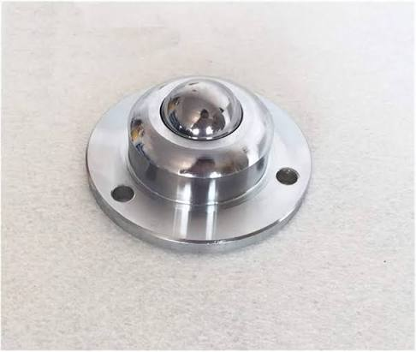
Drive mechanism
FRONT
Two rear 12 V DC gear motors (M1, M2) drive the robot.
Same direction and speed: straight or reverse.
Opposite directions: robot rotates on the spot into the room.
Front ball wheel only supports the load; the rear motors control the direction.
Ball wheel
Controller
and battery
M1
M2
Front ball-transfer wheel
Passive and omnidirectional: no steering part needed.
Top view
Notes:
Two driven wheels at the back give differential steering. The front wheel is a passive ball-transfer unit that only supports the robot.

Slide 9
Technical specifications
Subsystem | Specification
Controller | Arduino UNO
Path sensing | 1 IR sensor, digital output, 3.3 to 5 V; counts tape columns
Obstacle sensing | 2 IR sensors (front and back), digital output, 3.3 to 5 V
Drive | 2 rear 12 V DC gear motors, front ball-transfer wheel, dual-channel driver
Room input | 7 push buttons: rooms 1 to 6 and Home
Display | 16x2 LCD with I2C interface, 5 V
Power | Rechargeable battery for motors and electronics
Structure | Two-tier lightweight chassis with enclosed supply compartment
Notes:
Specifications taken from the project report appendix. Offer to share the circuit diagram and CAD views.

Slide 10
What is new: the innovations
1
Column-count navigation
2
Room-to-turn rule
One IR sensor counts floor columns to find the room.
Column number sets the distance; odd or even room sets right or left turn.
Replaces: camera, SLAM, sensor array
Replaces: map-based path planning
3
Stored-room return
4
Two-way obstacle guard
The robot remembers its room, reverses and takes the opposite turn Home.
Front and back IR sensors protect outward and return travel; it resumes when clear.
Replaces: stored map and route planner
Replaces: forward-only sensing
Notes:
Four ideas that work together. The first three are the heart of the invention. Each replaces something existing robots need.

Slide 11
Why this can be patented
Novelty
Inventive step
Column counting, room-based turn and stored-room return, combined in one hospital robot.
One IR sensor reaches a chosen room; known robots need cameras, SLAM or arrays.
Argument: simpler, cheaper result
Industrial use
Technical effect
Built as a working prototype; usable in hospitals, labs and isolation wards.
Reaches a room and returns with no mapping, safe in both directions.
Evidence: working prototype
Evidence: tested on 3-column track
Notes:
Walk the four tests: novelty, inventive step, industrial applicability, technical effect. Be clear that the prior-art search is pending, so these are arguments to test with the expert.

Slide 12
Draft claims
Independent claim (draft): a delivery robot comprising
Dependent claims
a
a chassis with two rear drive motors and a front ball-transfer wheel
Stop and resume on obstacle
Seven-switch room selector
I2C LCD status display
Front ball-transfer wheel
Website dispatch request
Method claim for the same steps
b
a room selector
c
a path IR sensor facing the floor
d
front and back obstacle IR sensors
e
a controller that counts path columns, turns at the selected room's column to a side set by the room number, stores the room, and on a return command reverses and turns the opposite way
Notes:
This is a first draft to discuss, not final wording. The independent claim lists the parts and what the controller does.

Slide 13
Compared with existing systems
Feature | Commercial robots | Camera / SLAM robots | This robot
Cost | High, proprietary | High (camera, computer) | Low: about Rs. 2,870
Navigation | Maps and sensors | Camera, AI, SLAM | One IR sensor, column count
Controller | Embedded computer | PC or ROS2 board | ATmega328P (Arduino UNO)
Room choice | Software destinations | Label recognition | Six room buttons plus Home
Return | Planned route | Planned route | Reverse, stored room
Set-up | Mapping and tuning | Training and mapping | Tape columns on floor
Notes:
Existing columns describe typical systems, not specific patents.

Slide 14
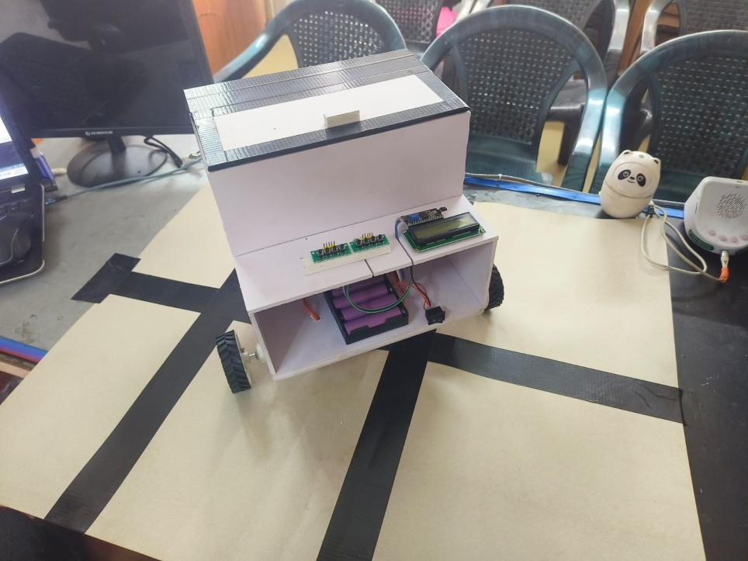
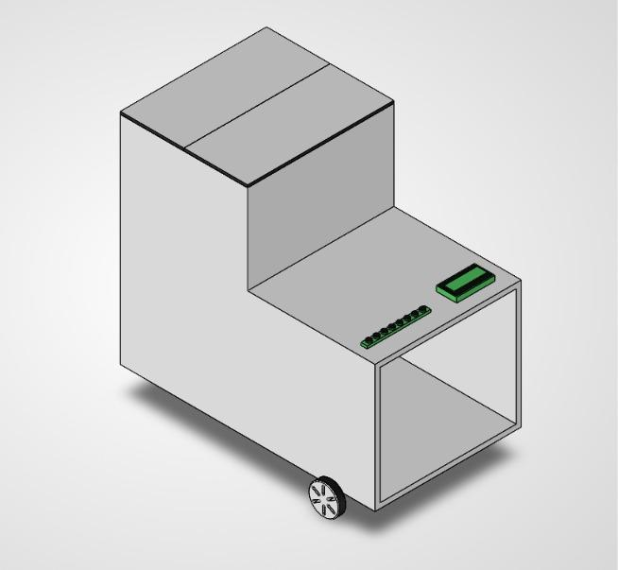
Prototype: proof it works
Prototype on test track
Prototype, isometric view
3D CAD model
Functions tested on the 3-column track
✓ Room selection
✓ Column detection
✓ Room turning
✓ Obstacle stop
✓ Return Home
Notes:
The prototype was built and tested on a 3-column track. CAD views and the circuit diagram can become patent drawings.

Slide 15
Next steps and questions
Next steps
Questions for the expert
Run the prior-art search
Finalise drawings from CAD and circuit
Draft claims with the patent agent
Decide filing route and timing
Link the MediRoute website to the robot
Which features make the strongest claims?
Claim a system, a method, or both?
Is the room-to-turn rule with stored-room return patentable?
How do we handle public disclosure before filing?
Notes:
Ask these questions to the expert. Public disclosure before filing is important because review presentations are public.

Slide 16
Thank you
Questions and guidance are welcome
Mechanical Engineering, KIOT Salem

